Slide 1
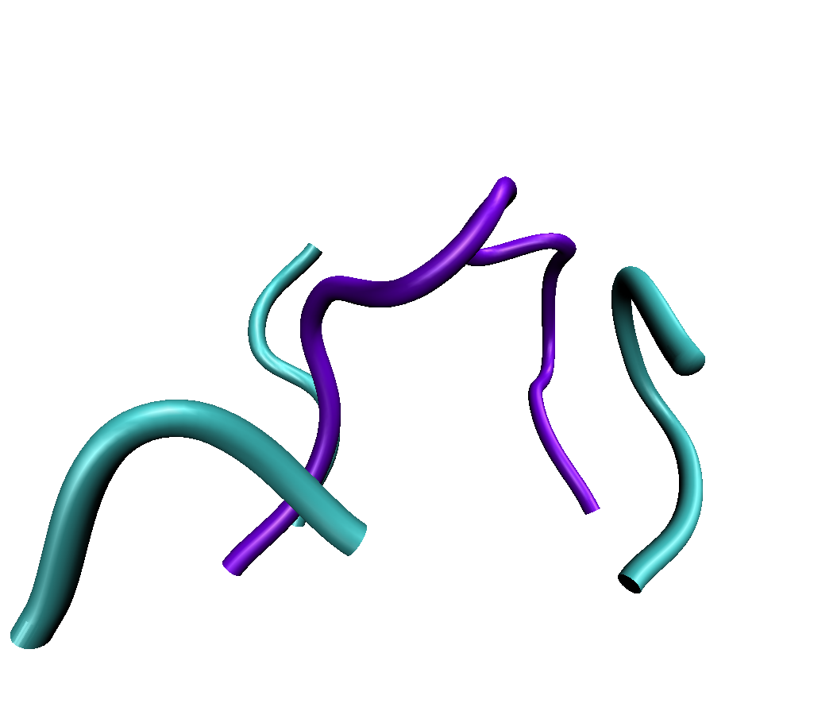
RosettaAntibodyDesign (RAbD)
Jared Adolf-Bryfogle, PhD
PhD Advisor: Dr. Roland Dunbrack
Postdoctoral Advisor: Dr. William Schief

Slide 2
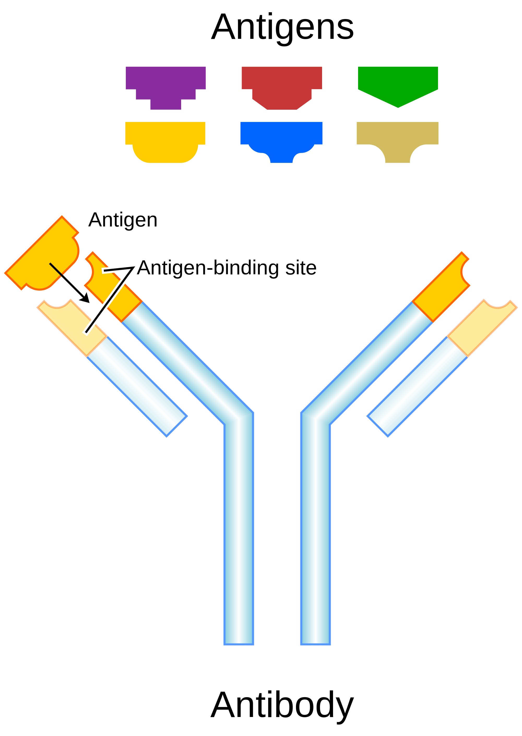
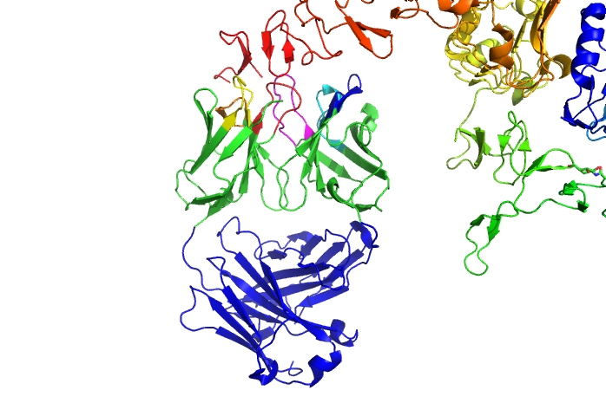
Antibody Structure
Two protein chains
Light (L) and Heavy (H)
1 Gene locus codes for Heavy chain
2 Gene loci code for Light chain (Lambda/Kappa)
6 Complementarity Determining Regions (CDRs)
Highly variable in length, structure, and sequence
Antibody Framework
Highly conserved for each gene locus
L
L
H
H
Antigen
CDRs
Framework

Slide 3
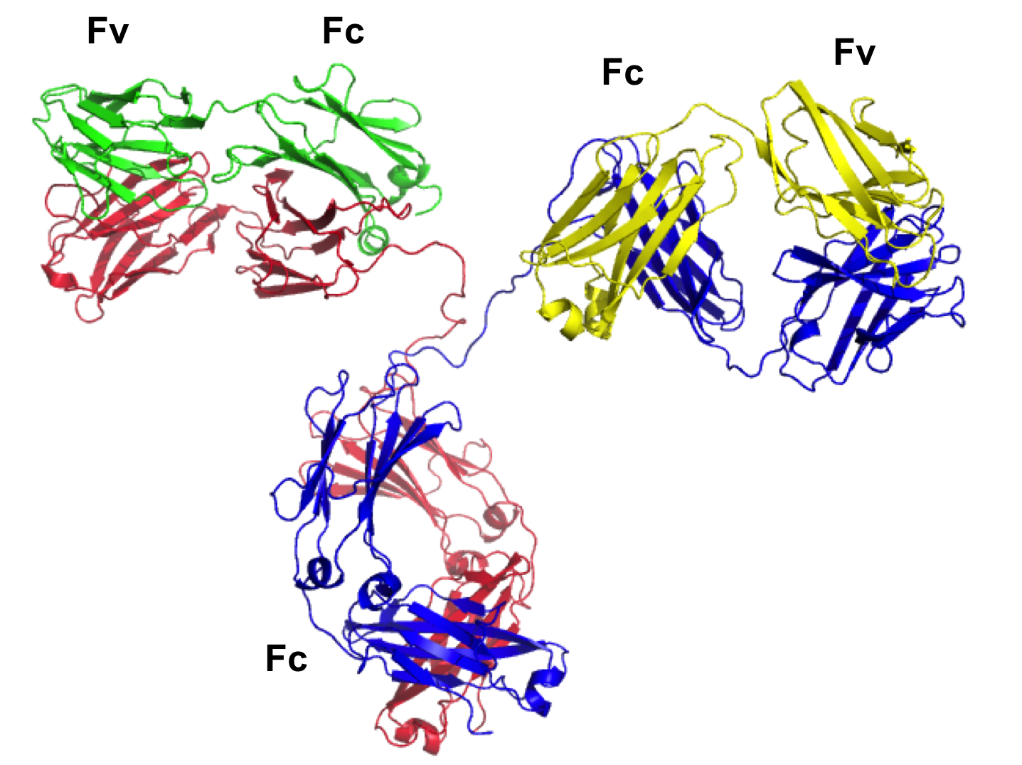
Antibody Structure – Full IgG
L
L
H
H
Fv - Variable
Fc - Constant
X-ray crystal structure of an antibody, full-length IgG (PDB ID 1IGT).
Light Chain – Green/Yellow
Heavy Chain – Red/Blue

Slide 4
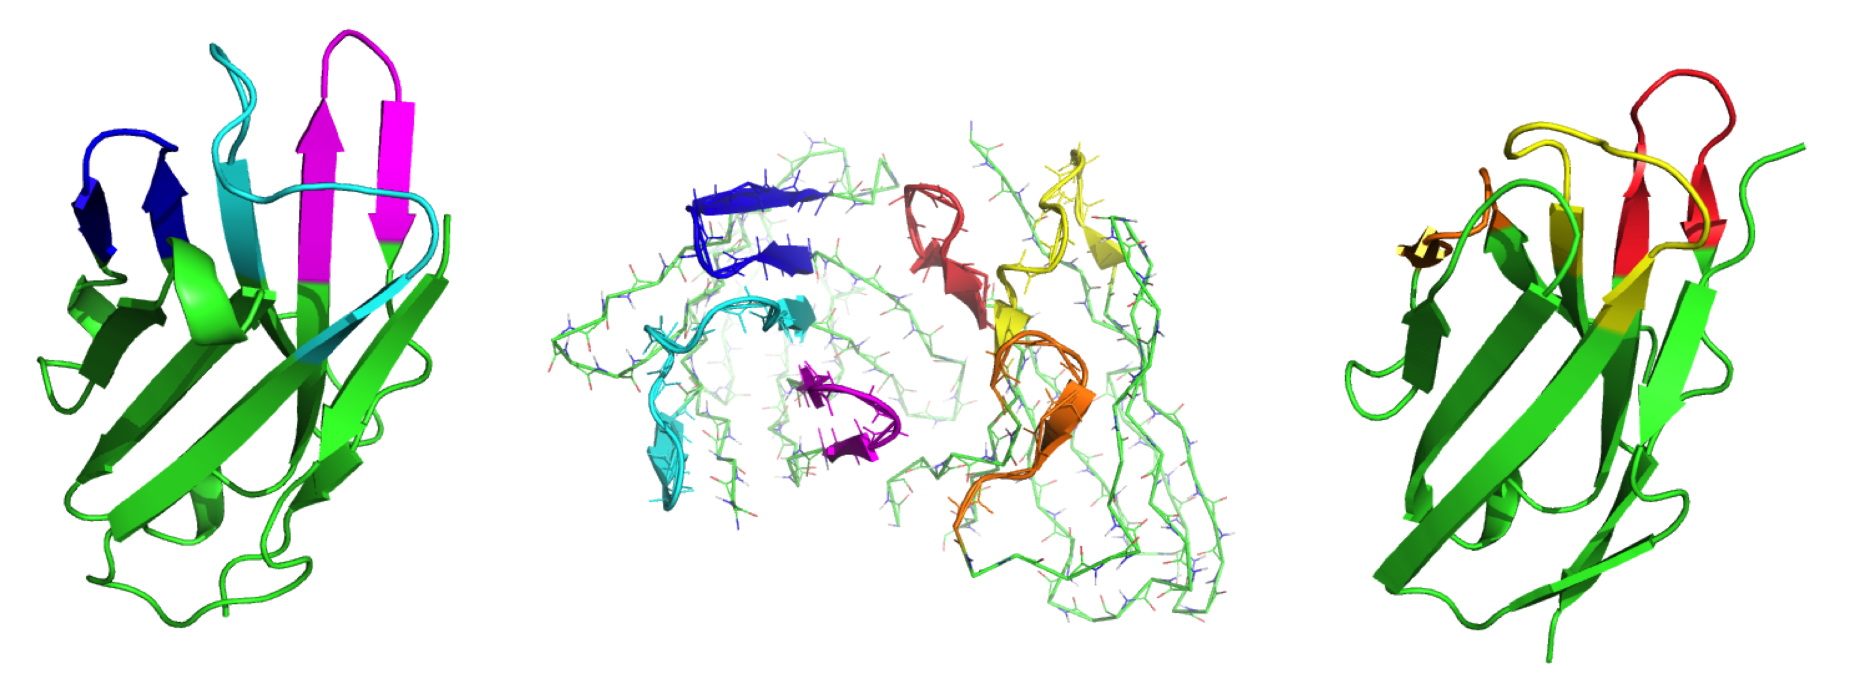
Antibody Structure Fv Fragment and CDRs
H2
L3
L1
Heavy Chain
Light Chain
H1
L2
H3
Framework
Framework
X-ray crystal structure of an antibody, Fv (PDB ID 2J88).

Slide 5
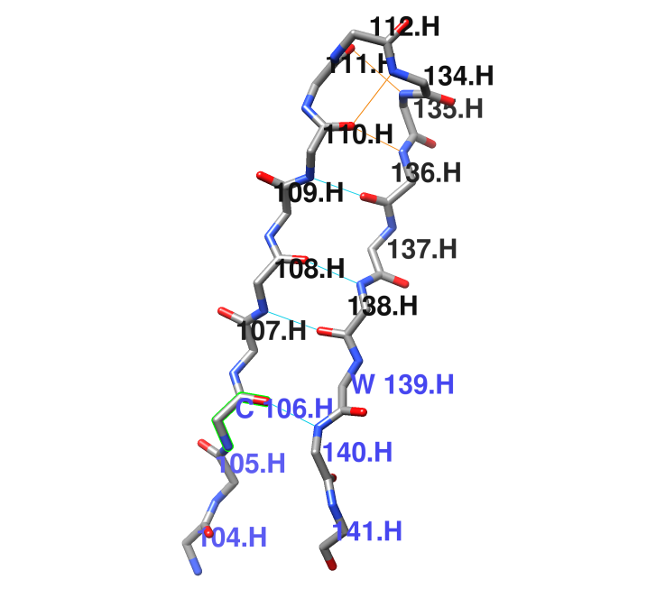
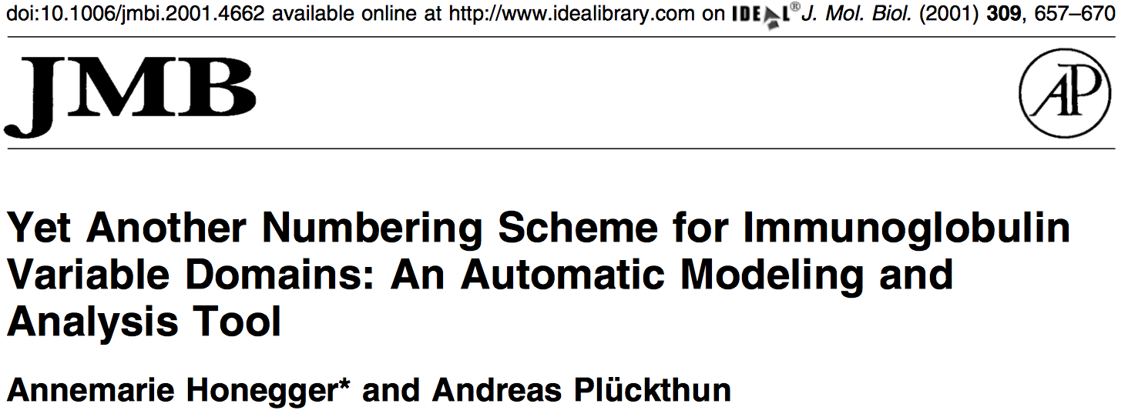
PyIgClassify: Antibody Identification
Identifies from Sequence:
Antibody chains
Antibody gene
Germline
CDR/Framework positions
Renumbers PDB Structures
AHo Numbering Scheme
North/Dunbrack CDR Definitions
Notes:
Sequence, structure, cluster information for antibody design

Slide 6
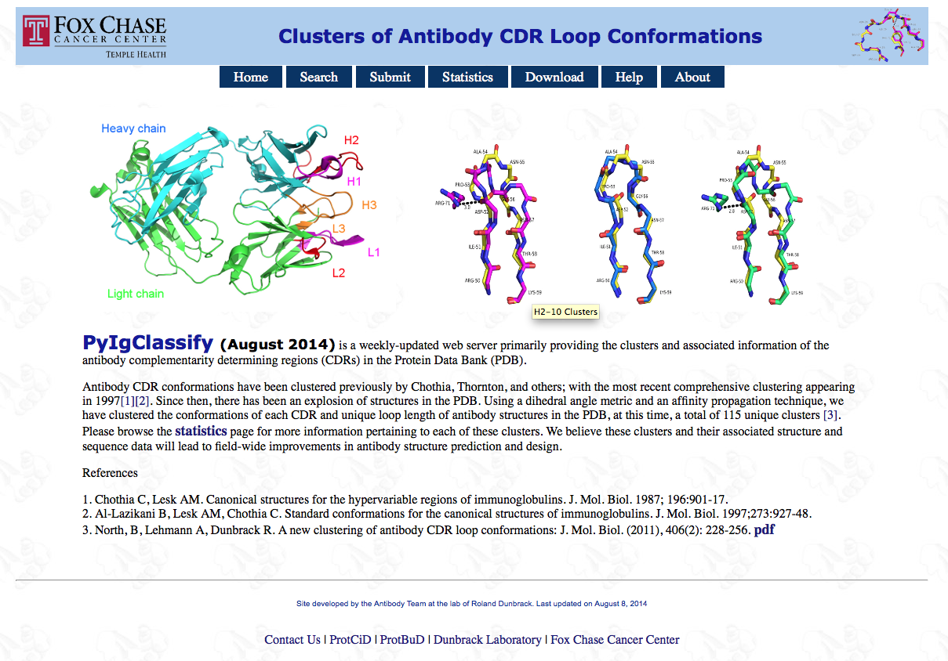
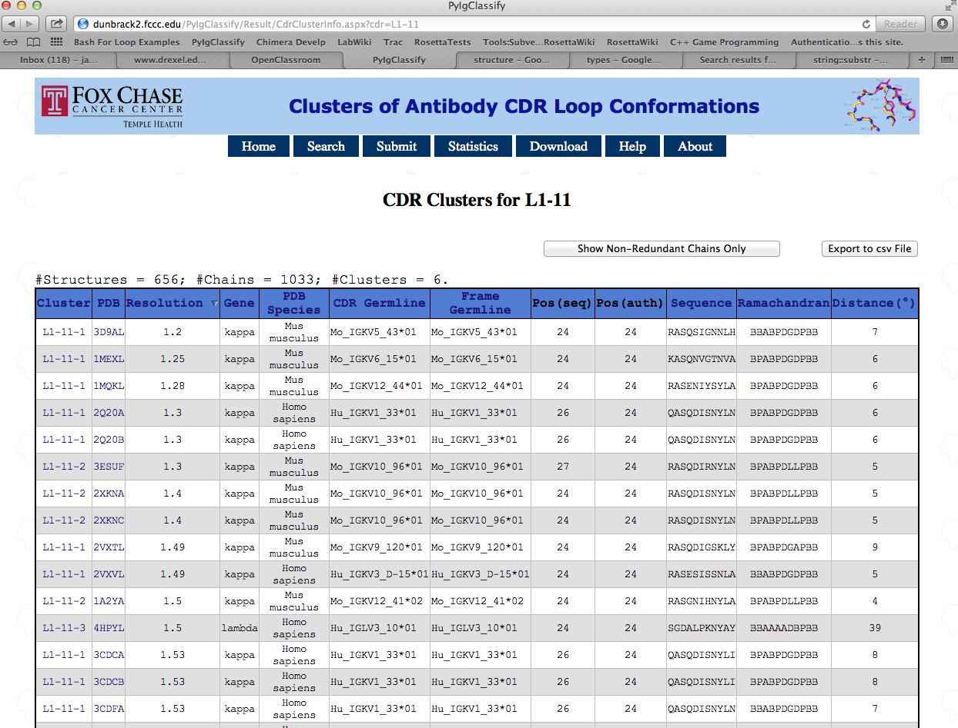
PyIgClassify: Server Frontend
Qifang Xu
Updates Bi-Yearly
Includes all Antibodies of the PDB
Submit
Explore
Download
http://dunbrack2.fccc.edu/PyIgClassify/

Slide 7
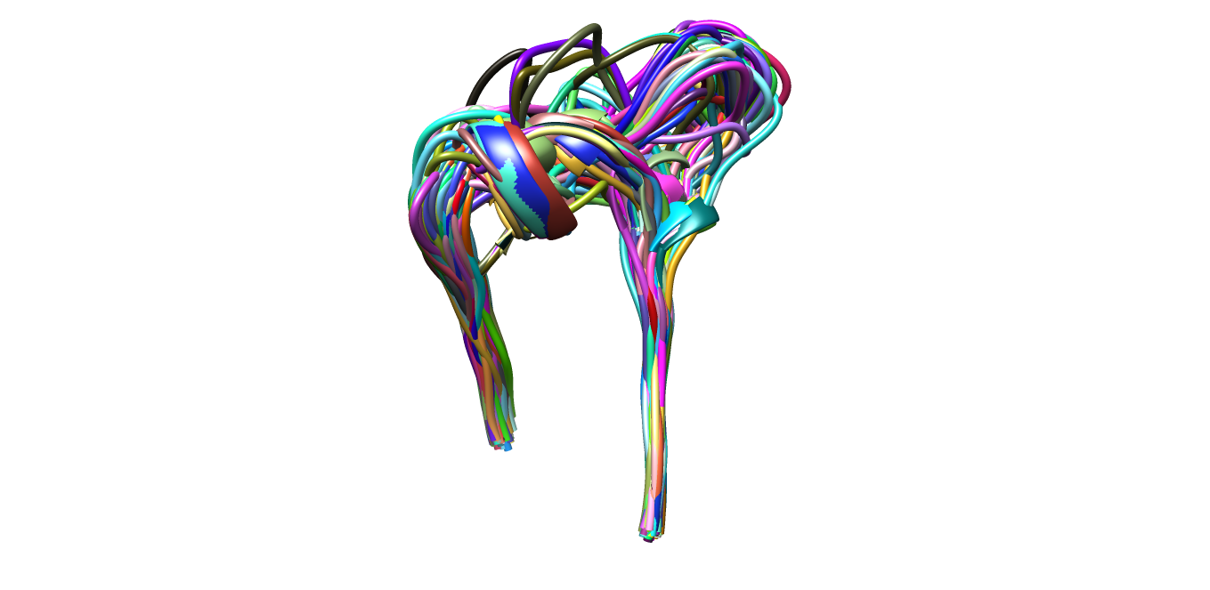
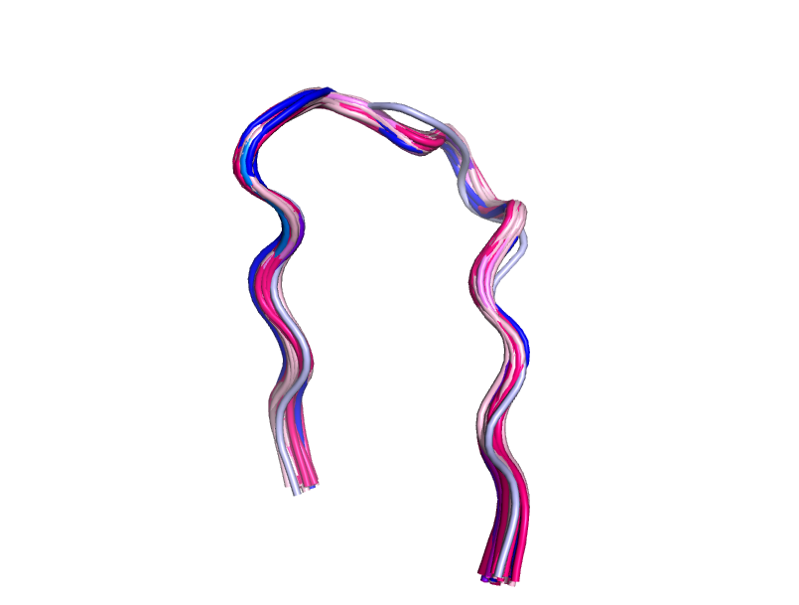
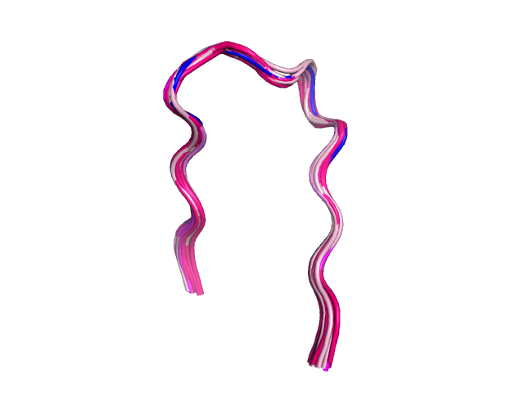
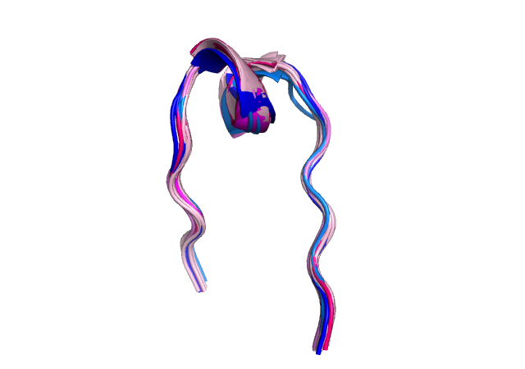
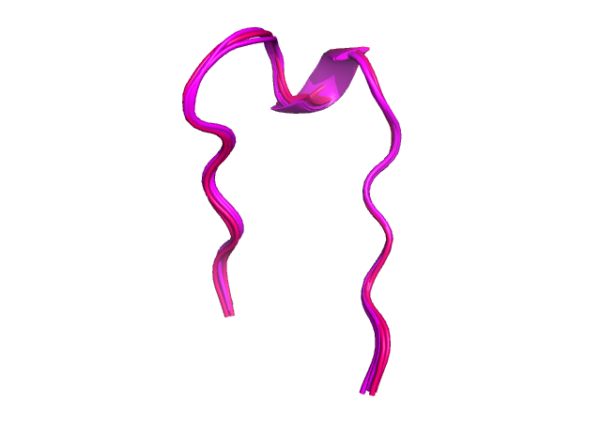
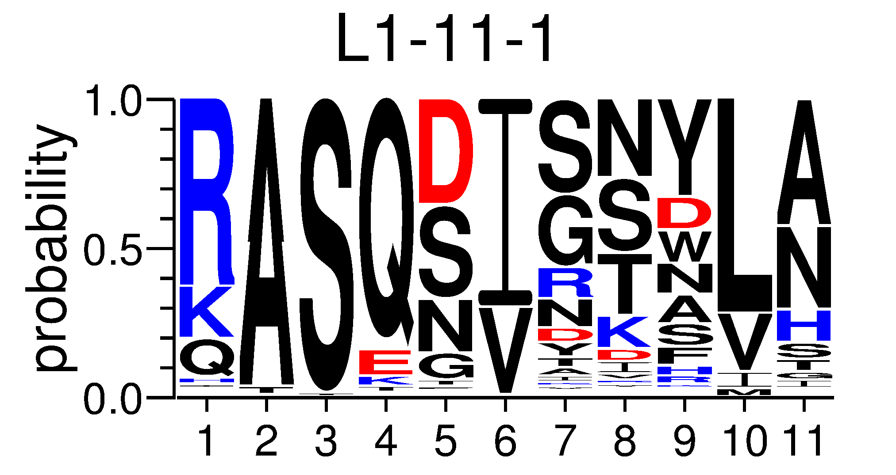
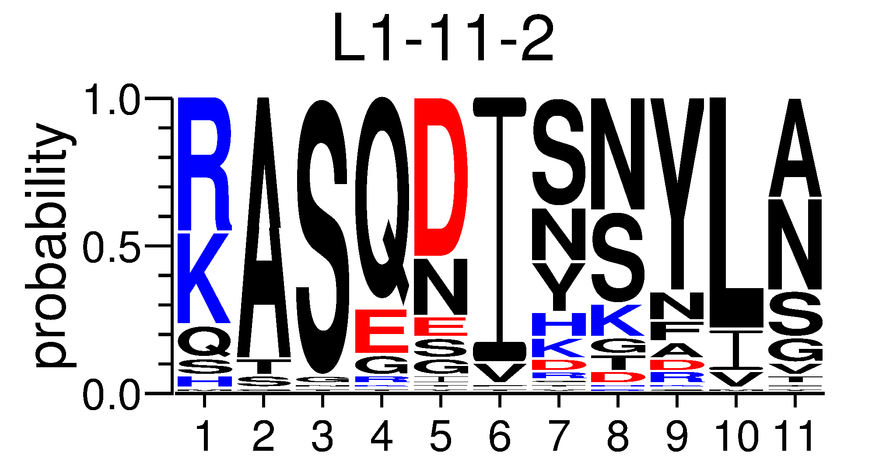
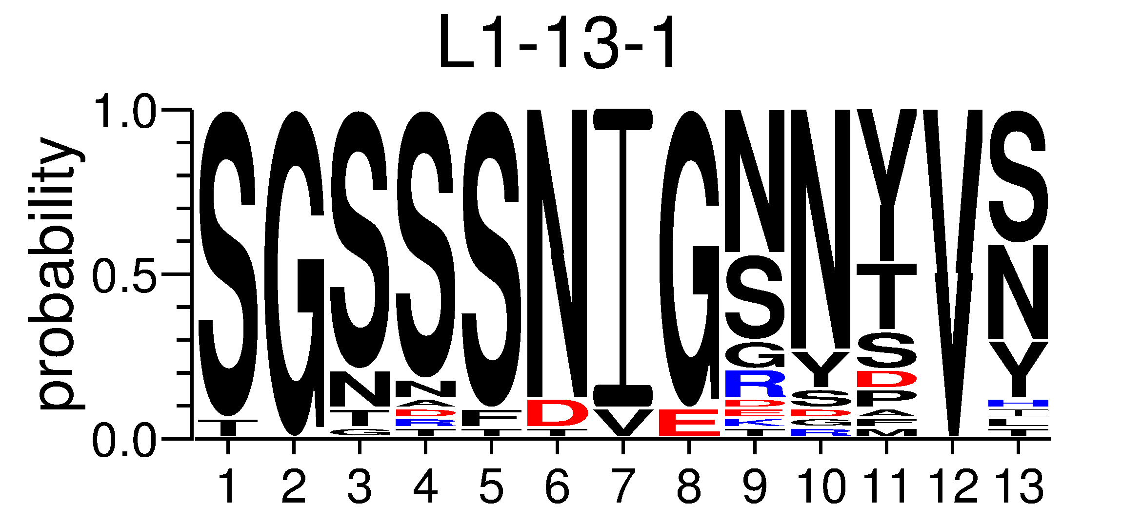
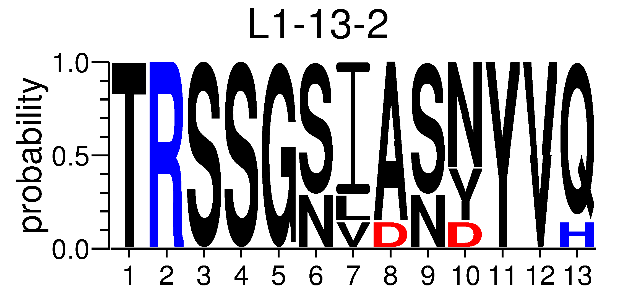
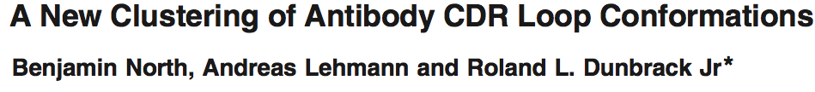
CDR Clustering
Cluster: Group of similar structures
Bioinformatic Analysis
High quality data set
72 Non-H3 clusters
Consensus
Sequence
Conformation
Knowledge-Based Antibody Design
JMB
Notes:
Make sure to say that L1-11-1 and L1-11-2 have mutations in the framework (Phe->Tyr)
Also – Affinity Propagation techniques using a dihedral angle metric

Slide 8
RosettaAntibodyDesign (RAbD)
Knowledge-Based Antibody Design
Application - Application can be used for many antibody design projects
Affinity Maturation
Homologous redesign
Stability improvement
De Novo design
Framework - set of components we can use in PyRosetta or RosettaScripts

Slide 9
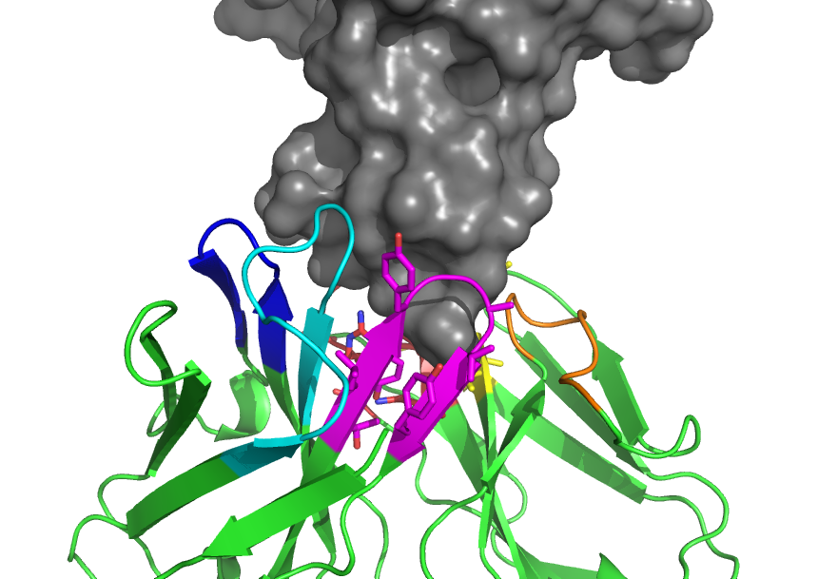
Antibody Designer: Overview
Monte Carlo Algorithm.
Whole CDR Sampling (GraftDesign)
Sample structures from database
Insert and optimize peptide bond without CDR disruption
New Graft Algorithm
100% Closure
Roughly mimics
Somatic Recombination
Sequence Sampling (SeqDesign)
Sample amino acid types
According to CDR Cluster Profiles
Roughly mimics
Somatic Hypermutation
Notes:
Structures with side-chains

Slide 10
Antibody Designer: Overview
Structure Optimization
Change/Sample DOF to minimize total energy of system
Integrated binding energy optimization instead of total energy
Constraints
Dihedral constraints
Circular Harmonic
CDR Cluster based
Epitope/Paratope constraints
Site Constraints
Lambda/Kappa specific design

Slide 11
Antibody Designer: Optional CDR File Overview
Allows Tailored Design
Strategy-based Design
Redesigns, de novo design, etc.
Simple Syntax
CDR-Level Control

Slide 12
Antibody Designer: CDR Instruction File Example
ALL GraftDesign ALLOW
ALL SeqDesign ALLOW
ALL CDRSet EXCLUDE PDBIDs 1N8Z 3BEI
L1 CDRSet EXCLUDE Clusters L1-11-1
L2 CDRSet INCLUDEONLY CLUSTER L2-8-1
L3 CDRSet STAY_NATIVE_CLUSTER
First Column: CDR or ALL
Second Column: Option Type
Capitalization Ignored

Slide 13
Example Command-Line
antibody_designer.default.linuxclangrelease –s my_ab.pdb ‑nstruct 500 ‑seq_design_cdrs L1 L2 L3 ‑light_chain lambda –optimize_dG

Slide 14
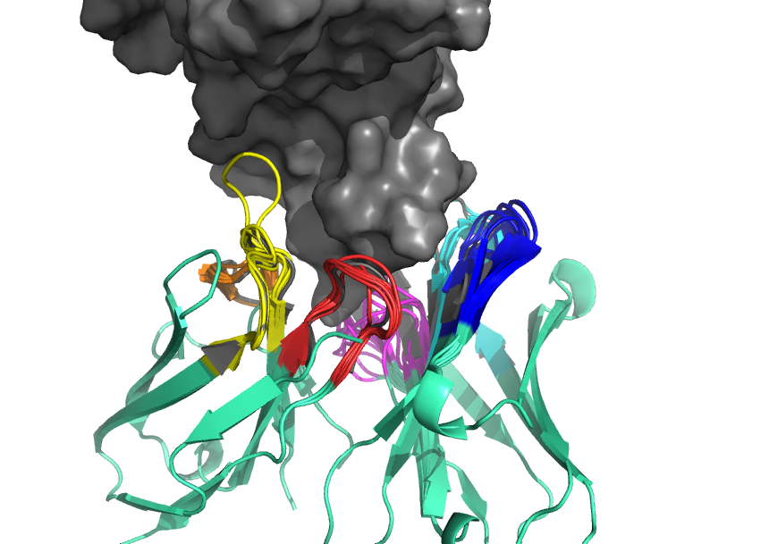
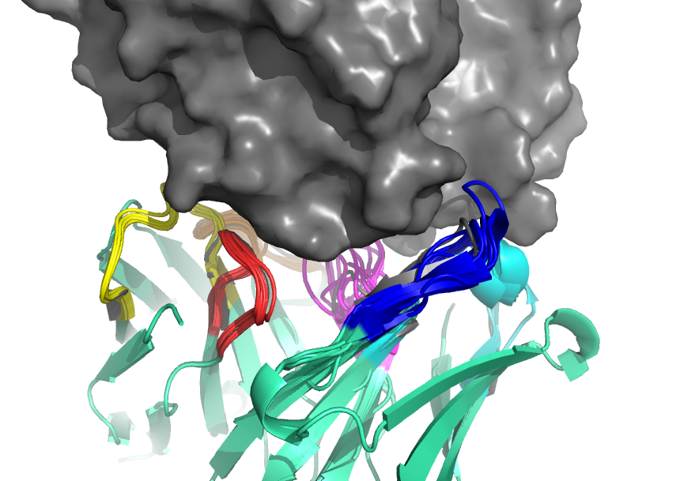
Top Decoy Examples
L1
L1
H2
L3
H2
L3
2j88
2dqc

Slide 15
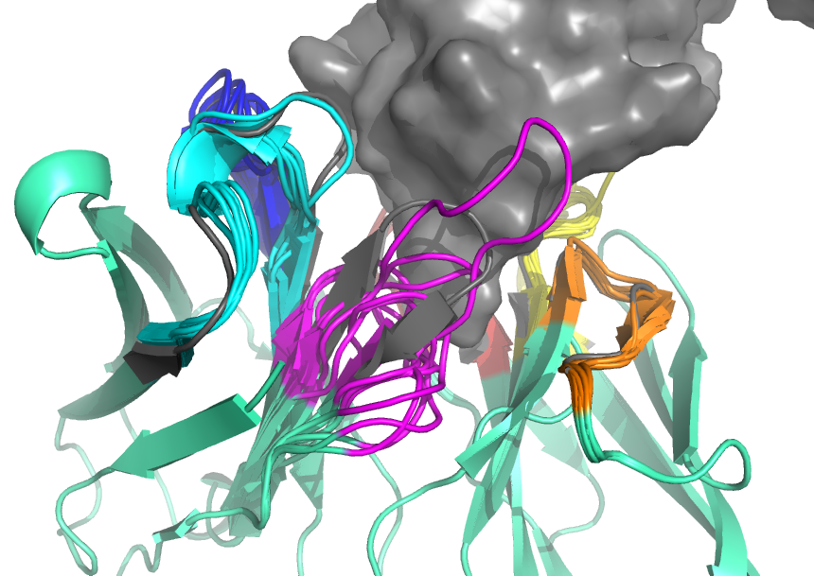
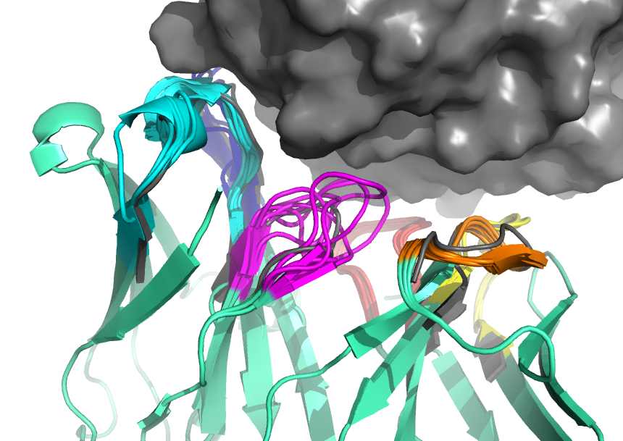
Top Decoy H3 Variability
H1
H1
L2
L2
H3
H3
2j88
2dqc

Slide 16
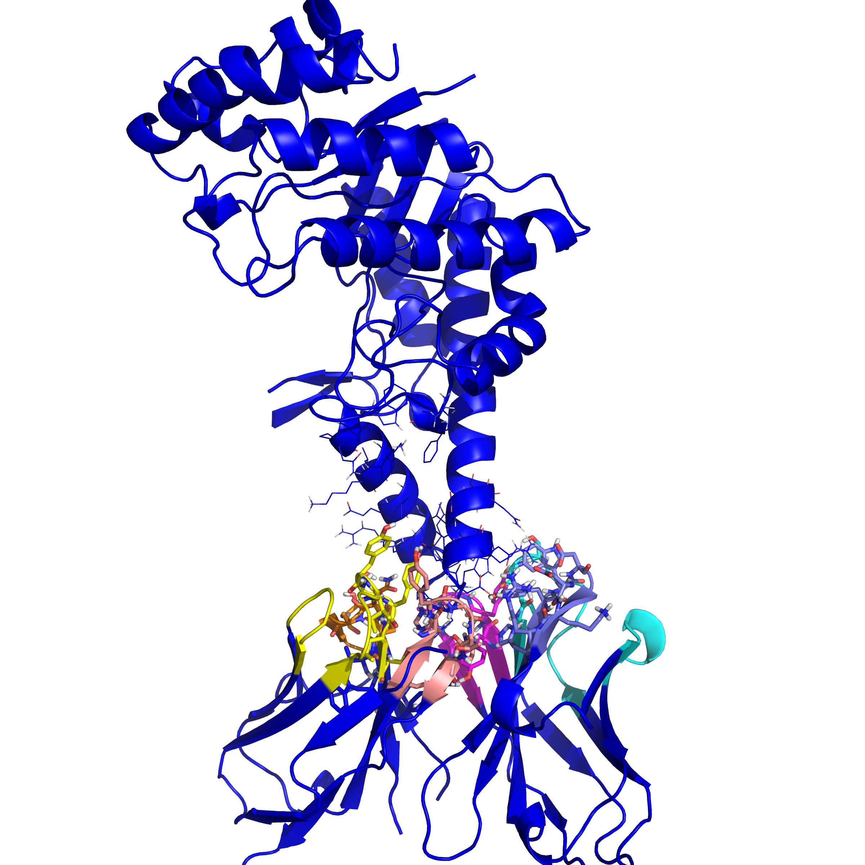
2J88 Antibody Improvement
Antibody binds to Bee Hyaluronidase
Major allergen of Bee Venom
Binds at 15.6 nM
Top design binds 2.5 nM
Designed L1/L4 (DE framework)
Designed H2
Dock/No Dock, only CDRs with profiles

Slide 17
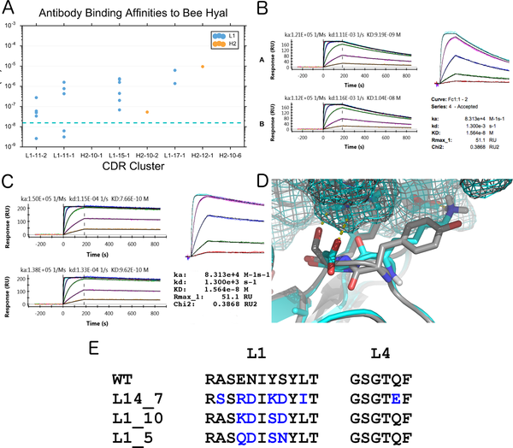

Fig 8. Designed antibodies against bee hyaluronidase.
Adolf-Bryfogle J, Kalyuzhniy O, Kubitz M, Weitzner BD, Hu X, et al. (2018) RosettaAntibodyDesign (RAbD): A general framework for computational antibody design. PLOS Computational Biology 14(4): e1006112. https://doi.org/10.1371/journal.pcbi.1006112
https://journals.plos.org/ploscompbiol/article?id=10.1371/journal.pcbi.1006112

Slide 18
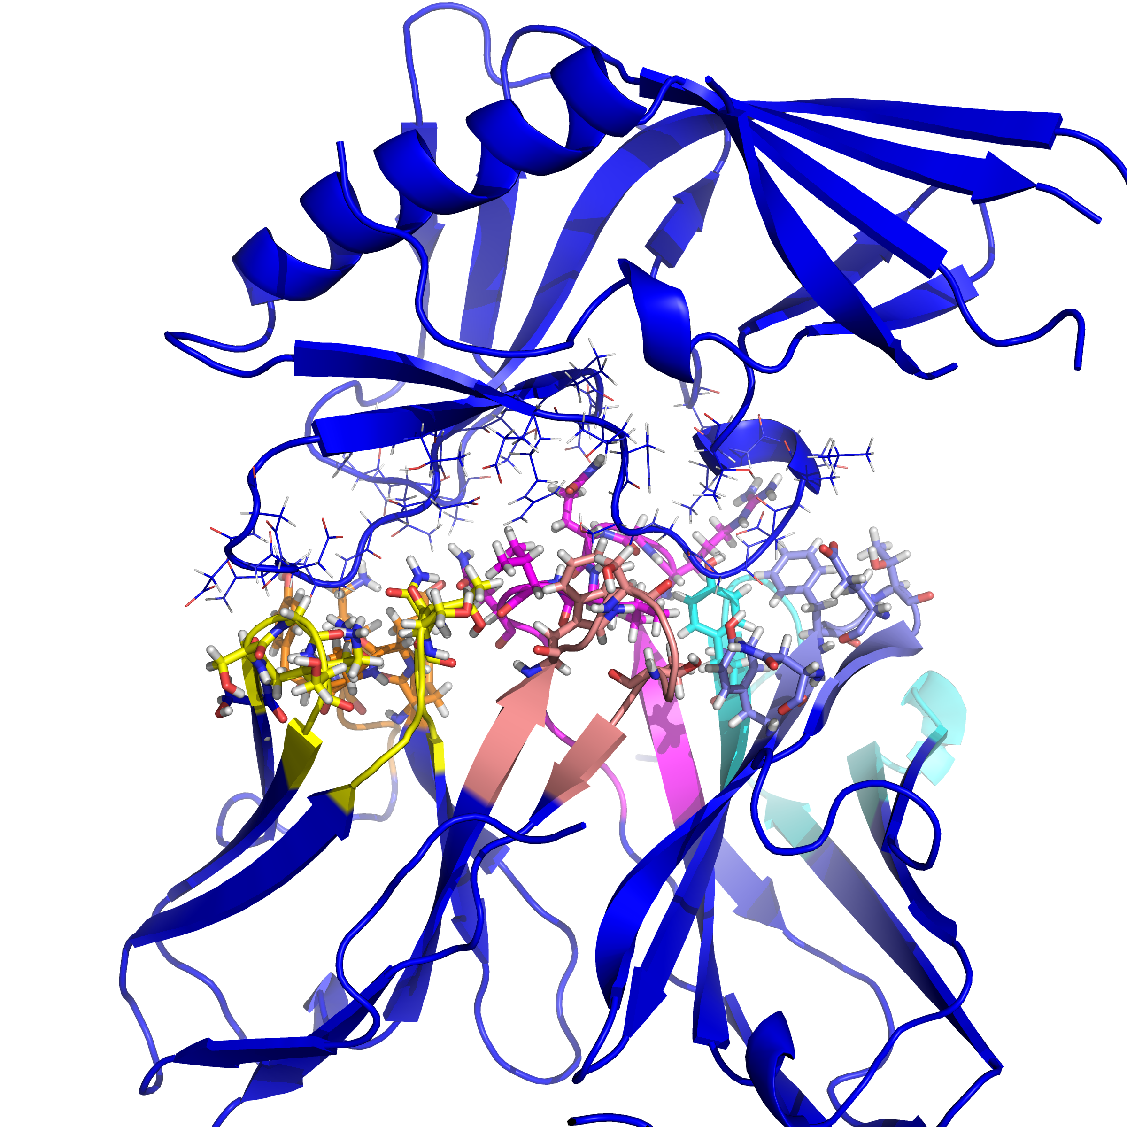
CH103 Antibody Improvement
Antibody binds to CD4 GP120 binding site
ZM176 Crystal 4JAN
CH103 binds 4JAN at 2.30 x 10⁻⁰⁶ M
Designed L1/L3
Designed H2

Slide 19
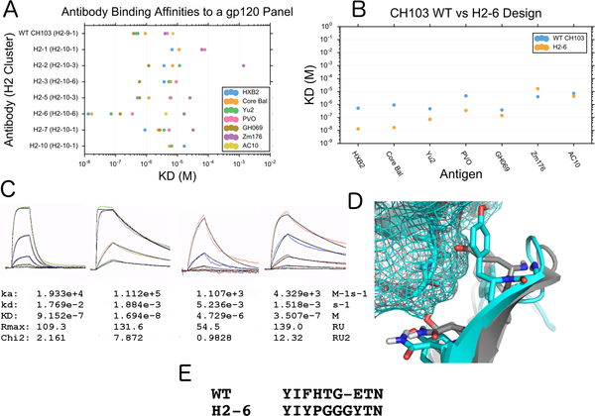
Fig 9. Binding of designed antibodies to HIV gp120.
Adolf-Bryfogle J, Kalyuzhniy O, Kubitz M, Weitzner BD, Hu X, et al. (2018) RosettaAntibodyDesign (RAbD): A general framework for computational antibody design. PLOS Computational Biology 14(4): e1006112. https://doi.org/10.1371/journal.pcbi.1006112
https://journals.plos.org/ploscompbiol/article?id=10.1371/journal.pcbi.1006112

Slide 20
Tutorial
1) Affinity improvement/Library Design using Sequence Design only
2) Redesign an antibody using GraftDesign and SequenceDesign
3) De Novo design using All-CDR Sequence Design and GraftDesign of various lengths and clusters
4) Custom protocol creation using RAbD components in RosettaScripts

Slide 21
Thanks!

